Slide 1


FlyNet: Mid Semester Review
October 21st, 2015
Critical Design Review

Slide 2
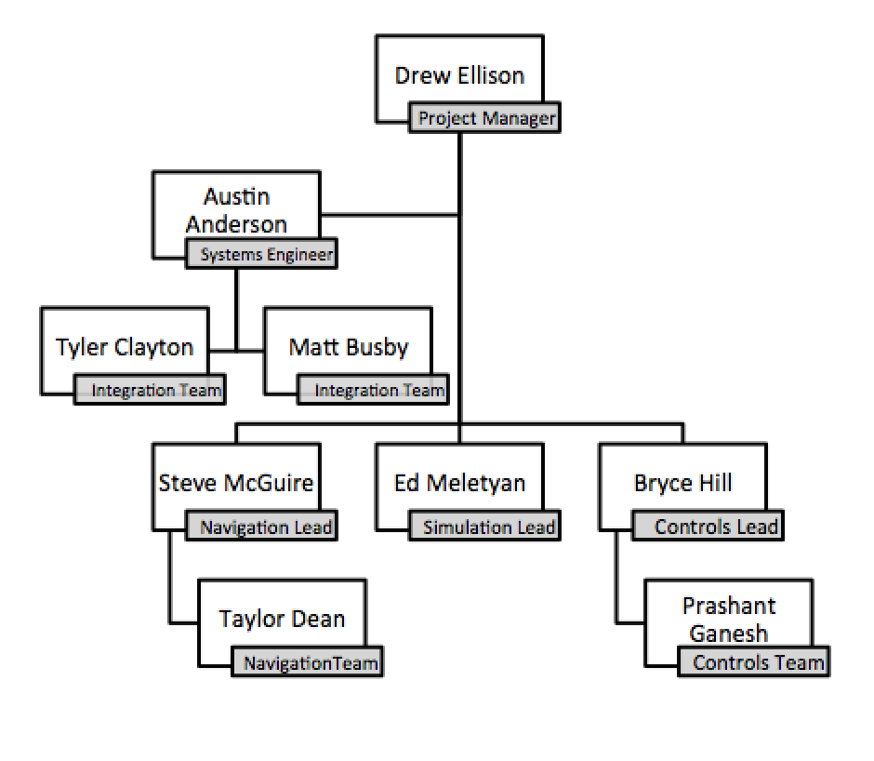
Organization Chart

Slide 3
Concept of Operations

Slide 4
Design Options

Slide 5
Design Comparison

Slide 6
Schedule

Slide 7
Budget

